Slide 1
Aim and Design specifications
Aim:
Design and implement a IR-based object/people counter using an 8051
(AT89S52/AT89C52) that detects beam breaks, increments/decrements a
count reliably, and displays it on a 7-segment/LCD with audible/LED
indication.
Applications: Library/store inventory entry/exit counting
Microcontroller:8051 (40-pin), e.g., AT89S52
Interfaces to be used : IR LED emitter + Photodiode/Phototransistor with bias & current-limit resistors
Expected Inputs: IR beam break/restore pulses from sensor pair (one or two beams if direction needed)
Expected Outputs: Count value shown on 7-segment

Slide 2
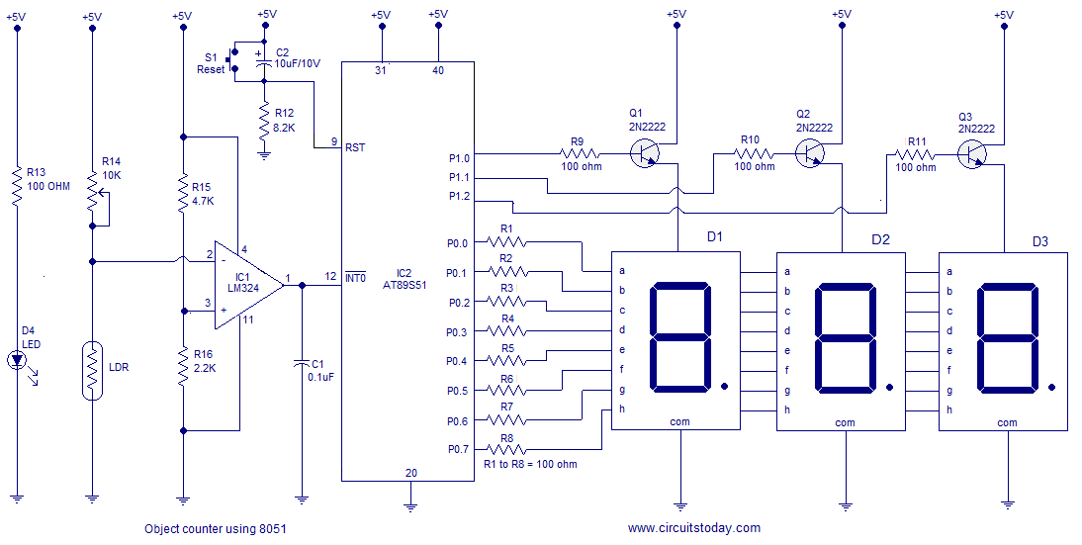
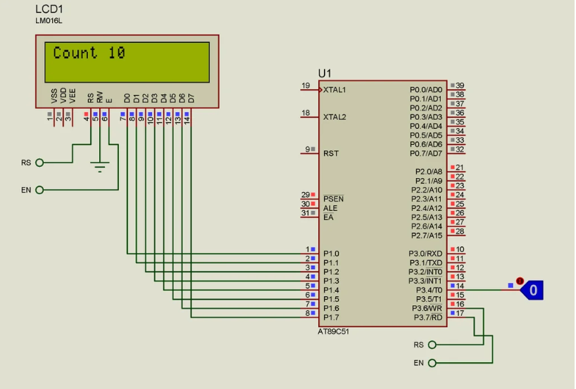
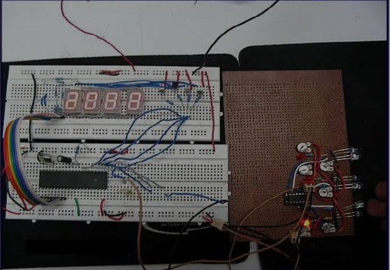
1.1 Literature Survey
Paper ID | Title | Year, Doi | Microcontroller (uC), input and output interfaces | Application | Parameters to consider | Image of circuit
1 | Design analysis and implementation of microcontroller-based infrared object counter | Year: 2021 DoI: | uC:8051 Input:IR sensor + comparator (LM339) Output:Seven-segment display showing entry/exit difference. | Object counting in gate-style scenarios. | Comparator thresholding, interrupt detection, count accuracy.
2 | Microcontroller-Based Bidirectional Visitors Counter | Year: 2022 DoI: | uC:8051 Input:Pair of IR sensors for detecting entry/exit, Output:Counters for entries and exits (possibly LCD or simple display). | People flow counting in halls/rooms. | Sensor alignment, bidirectional logic, real-time updating.
3 | Design and Construction of a Microcontroller-Based Infrared Object Counter | Year: Na DoI: | uC:AT89S51 (8051 family) Input:IR sensor detection Output:Count display (0–999) via display modules. | General-purpose object/person counter for industrial or institutional use. | Counting range, IR sensor placement, power supply constraints.

Slide 3
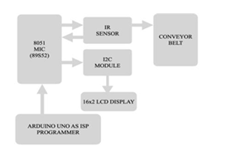
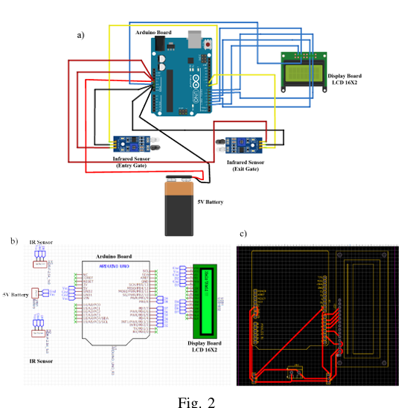
1.1 Literature Survey
Paper ID | Title | Year, Doi | Microcontroller (uC), input and output interfaces | Application | Parameters to consider | Image of circuit
4 | Low-Power Architecture for Real-Time Object Detection and Counting in Industry | Year: 2025 | uC:AT89S52 (8051 family) Input:IR sensors, interrupt signals16×2 LCD, motor driver circuit Output: | Conveyor belt object counting in industrial automation | Low power consumption, real-time accuracy, interrupt handling, scalability
5 | Design and Construction of a Microcontroller-Based Infrared Object Counter | Year: 2021 DoI: | uC:AT89S51 (8051 family) Input:IR sensor pair Output:7-segment display | Counting objects in labs and small-scale environments | Sensor sensitivity, distance limitations, reliability, ambient light effect
6 | Design and Development of Bidirectional Visitor Counter using Arduino UNO and IR Sensors | Year: 2023 DoI: | uC:Arduino UNO (ATmega328P) Input:Dual IR sensors (entry/exit detection) Output:16×2 LCD | Visitor counting in rooms, halls, and public places | Bidirectional counting accuracy, sensor alignment, response time, display clarity

Slide 4
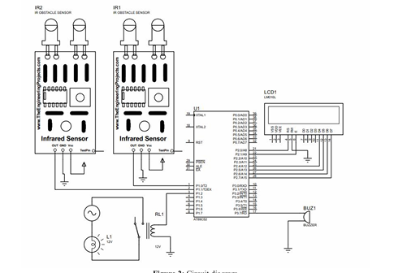
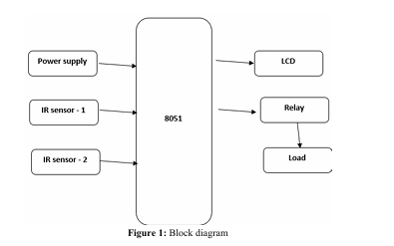
1.1 Literature Survey
Paper ID | Title | Year, Doi | Microcontroller (uC), input and output interfaces | Application | Parameters to consider | Image of circuit
7 | Automatic Counting Machine with IR-Sensor Based Counting Machine in Sorting Areas Using Conveyor Belt | Year2024: DoI: | uC:Arduino Uno Input:IR sensor (beam interruption detection) via emitter & receiver pairs Output:IR sensor (beam interruption detection) via emitter & receiver pairs | Automated object counting and sorting on conveyor belts—used in industrial/material-handling contexts like packaging or sorting areas | Sensor alignment and calibration, object detection reliability, conveyor speed synchronization, buzzer feedback, LCD readability, system robustness in industrial conditions
8 | Automatic Room Light Controller with Bidirectional Visitor Counter | Year: 2016 DoI: | uC:AT89S52 (8051 family) Input:Two IR sensor pairs (entry and exit detection) Output:7-segment display for count, relay driver for lighting control (light ON when occupied; OFF when empty) | Visitor counting and automatic light controller for energy-saving in rooms/halls—increments/decrements count and switches room light | Timing and sensor placement (bidirectional accuracy), debounce/false trigger handling, threshold for switching lights, reliability of 7-segment display in dynamic environments, power regulation (7805/12 V & 5 V)
9 | Automatic Room Light Controller with Bidirectional Visitor Counter (another variant/source) | Year:2021 DoI: | uC:AT89C52 (8051 family) Input:Two IR sensor pairs (entry and exit) Output:16×2 LCD display for visitor count, relay for light control | visitor counting with automatic light switching for rooms; improved display using LCD instead of 7-segment | Display clarity (LCD vs 7-segment), sensor reliability, light control thresholds, power supply regulation, microcontroller wiring, user-friendliness of UI

Slide 5
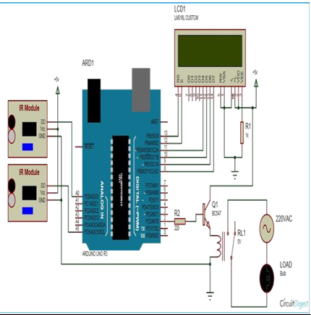
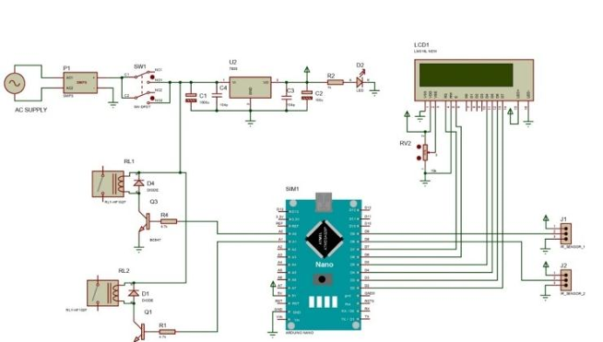
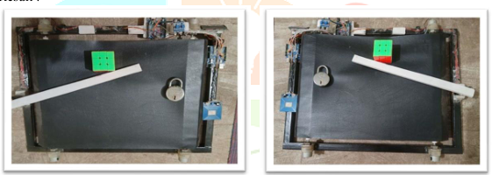
1.1 Literature Survey
Paper ID | Title | Year, Doi | Microcontroller (uC), input and output interfaces | Application | Parameters to consider | Image of circuit
10 | Automated Light Controller with Visitor Counter System | Year2018: DoI: | uC:(ATmega328P) Input:IR sensor(s) detecting entry/exit via beam interruption Output:LCD display for visitor count; relay-driven room lighting | Visitor counting with automatic control of room lighting—lights | Sensor placement, reliable detection logic for accurate counting, relay switching thresholds, LCD readability, power regulation (5 V from 12 V supply)
11 | Bidirectional Visitor Counter with Automatic Light and Fan Control | Year: 2022 DoI: | uC:Likely an 8051-family microcontroller Input:Dual IR sensors for detecting entry and exit movements Output:LCD display for count; output to control lighting and fan (likely via relays or drivers) | Bidirectional counting of visitors; automated control of lighting and fan to conserve energy when the room is vacant | Accurate entry/exit detection logic, debouncing, energy-saving thresholds, display clarity, coordination between lights and fan control modules
12 | Conveyor Belt Based Product Counting and Material Separation | Year: 2025 DoI: | uC:AT89C51 Input:IR sensors (for counting non-metal objects), inductive proximity sensors or metal detectors (for detecting metal); possibly ultrasonic or other sensors for separation logic Output:16×2 LCD display for count/status; servo motor (MG996R) to sort/divert items; conveyors driven by DC motors or controlled via drivers | Industrial automation for conveyor-based product counting and material separation (metal vs non-metal) to improve efficiency in packaging, recycling, or manufacturing | Accurate detection and timing, handling varying object sizes and speed, servo positioning accuracy, display feedback, scalability and reliability in industrial environments, sensor robustness

Slide 6
1.2 Workflow
Max Handling & Reset
Initialize System
Set threshold and reset count to 0
Detect and Debounce
Apply debounce (e.g., 50 ms)
Increment and Display
Increment count on valid detection
Update 7-segment display via IC or microcontroller
Power up the IR sensor and display driver
Monitor IR sensor for a clean edge
Handle max count (rollover or hold)
Reset via button to clear display

Slide 7
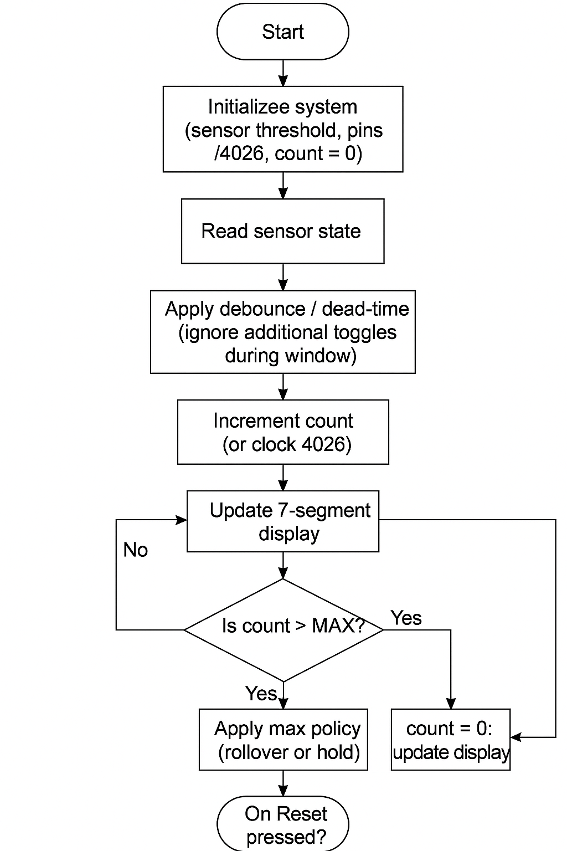
1.3 Expected Working Model (flow chart)

Slide 8
COMPONENTS REQUIRED
AT89C51 Microcontroller (8051 family) – the brain of the system
16×2 LCD Display – to show object count and status
IR Sensor Module – for detecting and counting objects on the conveyor
Inductive Proximity Sensor – for detecting whether an object is metal or non-metal
DC Motor – to drive the conveyor belt
Motor Driver IC (L293D or L298N) – to control the DC motor from the microcontroller
Servo Motor (MG996R/SG90) – to divert/sort objects into bins
Power Supply Module (LM7805 & LM7812 regulators + transformer/adapter) – to provide 5V and 12V regulated power
Crystal Oscillator (11.0592 MHz or 12 MHz) + Capacitors (33pF ×2) – for stable microcontroller operation
Reset Circuit (push button, 10µF capacitor, 10kΩ resistor) – to initialize/reset the microcontroller

Slide 9
REVIEW 2

Slide 10
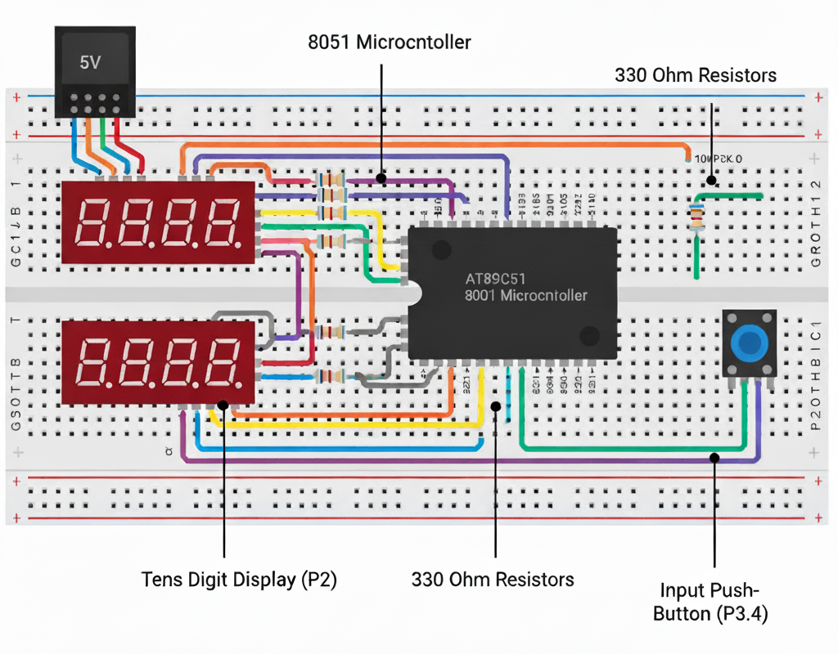
2.1 Preliminary Implementation
Parameters | Value
Microcontroller | AT89C51 (8051 Family)
Inputs | Ultrasonic Sensor (HC-SR04) — Trigger and Echo pins used for object detection
Input values | Logic LOW (0) → Object Detected Logic HIGH (1) → No Object
Output | 16x2 LCD Display connected to Port 2 (data) and Port 3
Output values | Displays message “OBJECT COUNT:” on line 1 and current count value on line 2
Paste your design’s image

Slide 11
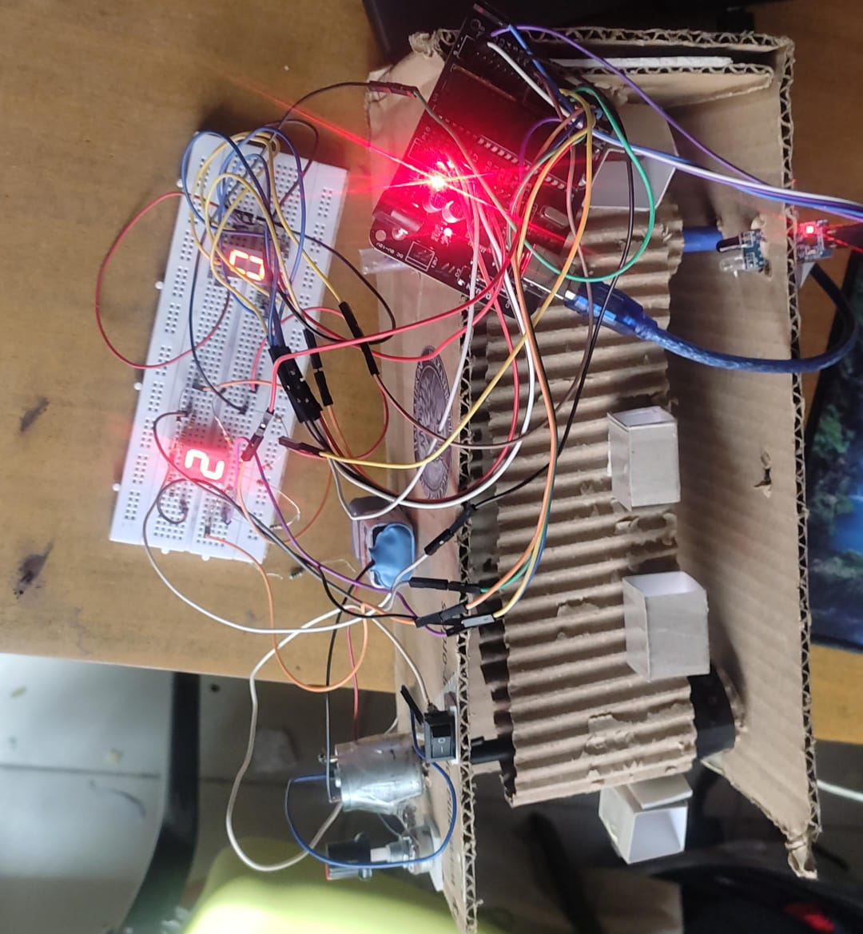
2.1 Preliminary Implementation
Paste your design’s image

Slide 12
2.1 Preliminary Implementation
ORG 0000H ; Program starts at memory address 0000H
COUNTL EQU 30H ; Define COUNTL as memory location 30H (units digit)
COUNTH EQU 31H ; Define COUNTH as memory location 31H (tens digit)
TEMP EQU 32H ; Define TEMP as memory location 32H (unused variable here)
MAIN:
MOV P2, #00H ; Clear Port 2 (used for displaying units digit)
MOV P1, #00H ; Clear Port 1 (used for displaying tens digit)
MOV P3, #0FFH ; Configure Port 3 as input (switches connected here)
MOV COUNTL, #00H ; Initialize units count = 0
MOV COUNTH, #00H ; Initialize tens count = 0

Slide 13
2.1 Preliminary Implementation
START:
JB P3.4, START ; Wait until button (P3.4) is pressed (active low)
ACALL INCREMENT ; Call subroutine to increment counter
WAIT_RELEASE:
JNB P3.4, WAIT_RELEASE ; Wait for button release (avoid multiple counts)
SJMP START ; Jump back to start and wait for next press
INCREMENT:
MOV A, COUNTL ; Load accumulator with units count
INC A ; Increment units digit

Slide 14
2.1 Preliminary Implementation
ACALL D ; Call delay subroutine (debouncing)
ACALL D ; Additional delay for stable display
CJNE A, #0AH, STOREL ; Compare A with 0AH (10), if not equal, go to STOREL
MOV A, #00H ; If units reached 10, reset to 0
MOV COUNTL, A ; Store 0 in COUNTL
MOV A, COUNTH ; Load accumulator with tens digit
INC A ; Increment tens digit
ACALL D ; Delay
ACALL D ; Delay
CJNE A, #0AH, STORET ; Compare with 10, if not equal, store it
MOV A, #00H ; If tens reached 10, reset to 0
STORET:
MOV COUNTH, A ; Store new tens digit

Slide 15
2.1 Preliminary Implementation
SJMP DISP ; Jump to display routine
STOREL:
MOV COUNTL, A ; Store new units digit
DISP:
; Display units on Port 2
MOV A, COUNTL ; Load units count
MOV DPTR, #SEGTAB ; Load address of seven-segment table
MOVC A, @A+DPTR ; Fetch corresponding 7-seg code from table
MOV P2, A ; Output to Port 2 (units display)
; Display tens on Port 1
MOV A, COUNTH ; Load tens count

Slide 16
2.1 Preliminary Implementation
MOV DPTR, #SEGTAB ; Load address of seven-segment table
MOVC A, @A+DPTR ; Fetch corresponding 7-seg code
MOV P1, A ; Output to Port 1 (tens display)
RET ; Return from subroutine
D:
MOV R1, #200 ; Outer loop count (R1)
D1: MOV R2, #255 ; Inner loop count (R2)
D2: DJNZ R2, D2 ; Decrement R2 until zero (inner delay)
DJNZ R1, D1 ; Decrement R1 until zero (outer delay)
RET ; Return from delay subroutine

Slide 17
2.1 Preliminary Implementation
SEGTAB:
DB 0C0H ; 0 → Display pattern for ‘0’
DB 0F9H ; 1 → Display pattern for ‘1’
DB 0A4H ; 2 → Display pattern for ‘2’
DB 0B0H ; 3 → Display pattern for ‘3’
DB 099H ; 4 → Display pattern for ‘4’
DB 092H ; 5 → Display pattern for ‘5’
DB 082H ; 6 → Display pattern for ‘6’
DB 0F8H ; 7 → Display pattern for ‘7’
DB 080H ; 8 → Display pattern for ‘8’
DB 090H ; 9 → Display pattern for ‘9’
END ; End of program

Slide 18
2.2 Preliminary Results
Results (if any)

Slide 19
2.3 Interfaces used
IR sensor
Connected with p3.4
7 segment dispaly Connected in 8-bit mode to Port 1 (or Port 2) for data lines D0–D7. Control pins connected to Port 3:
RS to P3.0
RW to P3.1
EN to P3.2 Used to display the message “OBJECT COUNT:” and the current count value.

Slide 20
2.4 Expected outcome to be shown in Final review
The system should detect each object passing in front of the ir sensor with good accurately.
The LCD display should show the message “OBJECT COUNT:” on the first line.
The current count value should be displayed on the second line of the LCD.
Each time an object passes the sensor, the count should increment by one automatically.
When no object is present, the display should retain the last counted value.
The system should work continuously and reliably without manual reset.

Slide 21
FINAL Review

Slide 22
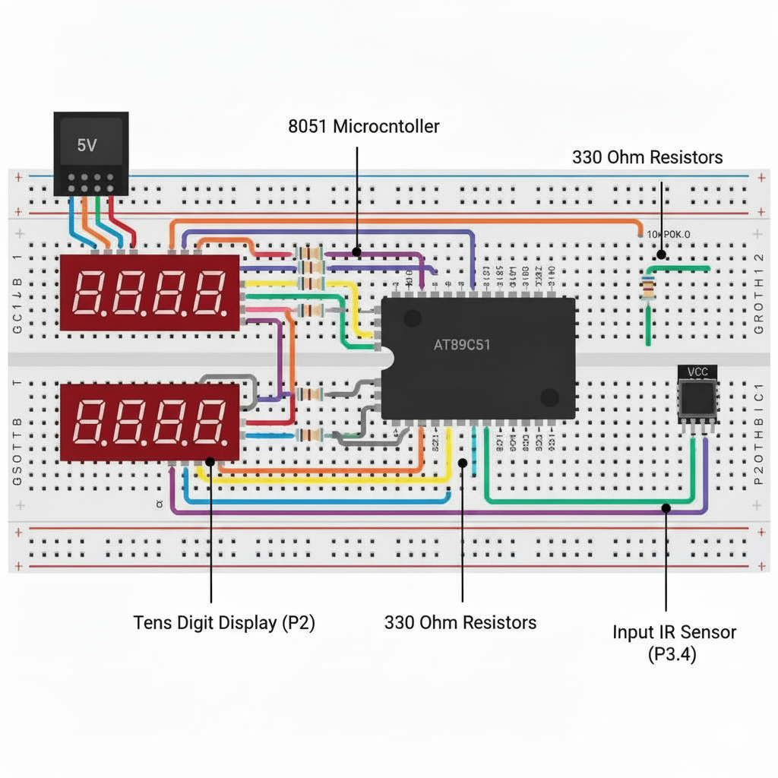
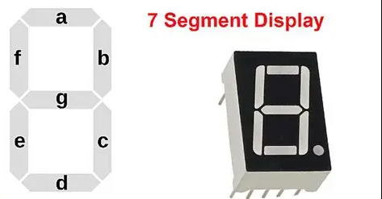
3.1 Complete design

Slide 23
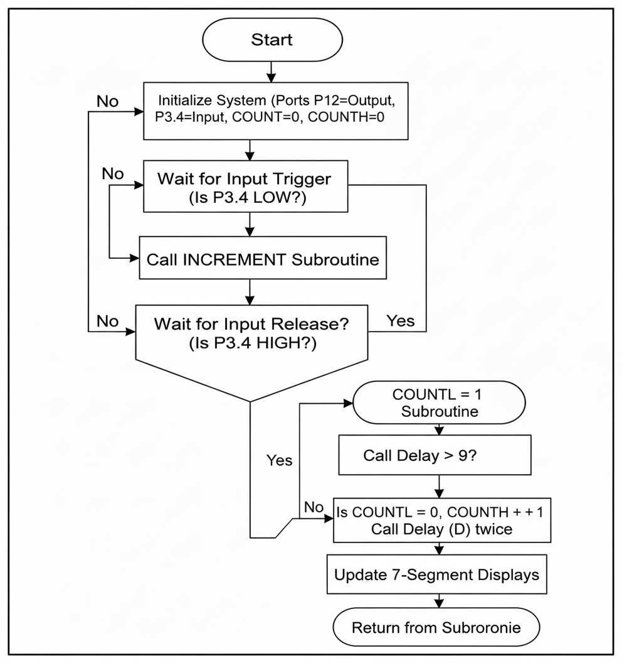
3.2 Flow chart

Slide 24
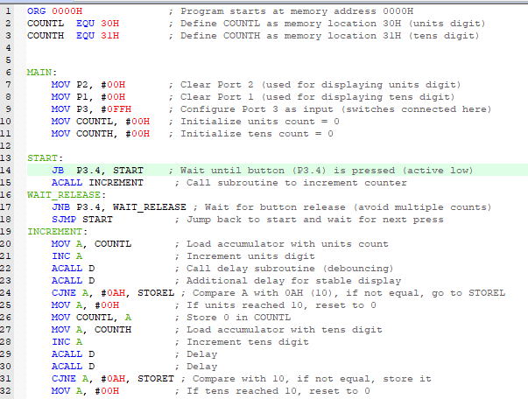
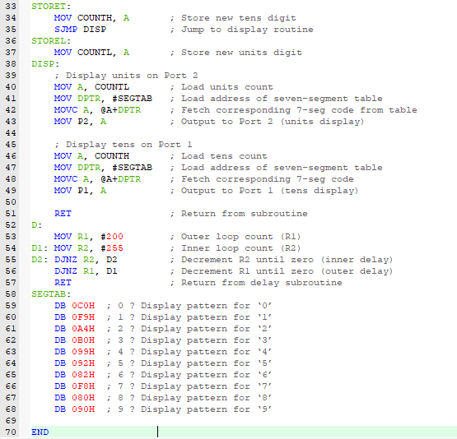
3.3 Software implementation (Assembly language codes)

Slide 25
3.4 Input and outputs
I/O Type | Component | Microcontroller Pin/Port | Function in Project
Input | IR Sensor (or Push Button) | P3.4 | Trigger: Detects an object (or button press). It is configured as Active-Low (JB P3.4).
Output | Units 7-Segment Display | Port 2 (P2) | Displays the Units Digit (0-9) stored in the COUNTL variable.
Output | Tens 7-Segment Display | Port 1 (P1) | Displays the Tens Digit (0-9) stored in the COUNTH variable.

Slide 26
3.5 Implementation with KITS (include images)
Assembler/IDE: Keil uVision
Used for writing and assembling the 8051 assembly language source code.
Generates the executable .HEX file (machine code).
Programmer: Universal 8051 Programmer (e.g., TL866II Plus)
Used to flash (load) the compiled .HEX file onto the non-volatile memory of the AT89C51 microcontroller chip.
Microcontroller: AT89C51 (or any 8051-family MCU)
Input Interface: Push Button Switch (or IR Sensor) connected to P3.4, with a 330 Pull-up Resistor.
Output Interface: Two Common Cathode 7-Segment Displays.
Current Limiting: 330Omega Resistors for each segment of the displays (total of 16 resistors).
Oscillator: 12MHz Crystal Oscillator with two Capacitors (for clock generation).
Power Supply: +5v DC regulated power supply.

Slide 27
3.6 Practical applications where this can be implemented
Category | Application Example | Function
Industrial/Retail | Production Line Counter | Tracks the number of items or components passing a sensor (up to 99) for inventory or batch control.
Security/Access | People/Visitor Counter | Counts individuals entering a small room, store, or event area by detecting movement across a beam.
Education/Testing | Microcontroller Lab Trainer | A fundamental circuit used in courses to demonstrate I/O configuration, lookup tables, and BCD logic in 8051 programming.
Simple Machines | Token/Coin Counter | Registers the number of payments or tokens in a basic vending or arcade machine mechanism.

Slide 28
3.7 Scope for future enhancements
Area | Enhancement | Purpose
Functionality | Up/Down Counting | Add a second input to allow the count to decrement, useful for tracking both entry and exit.
User Interface | Programmable Limit | Add buttons to set a maximum count (e.g., 50), triggering an alert instead of always rolling over at 99.
Reliability | Memory Retention | Save the current count to EEPROM (or Flash) so the tally is preserved across power failures.
Performance | External Interrupt | Connect the sensor to an interrupt pin ($\overline{\text{INT}0}$) instead of polling, making the system more power-efficient and responsive.
Output | Increase Range | Expand the hardware to three or more 7-segment displays to count up to 999 or higher.

